Slide 1

CHAPTER 10
GRAPHS AND TREES
Copyright © Cengage Learning. All rights reserved.

Slide 2
SECTION 10.6
Rooted Trees
Copyright © Cengage Learning. All rights reserved.

Slide 3
Rooted Trees
An outdoor tree is rooted and so is the kind of family tree that shows all the descendants of one particular person. The terminology and notation of rooted trees blends the language of botanical trees and that of family trees.
In mathematics, a rooted tree is a tree in which one vertex has been distinguished from the others and is designated the root.
Given any other vertex v in the tree, there is a unique path from the root to v. (After all, if there were two distinct paths, a circuit could be constructed.)

Slide 4
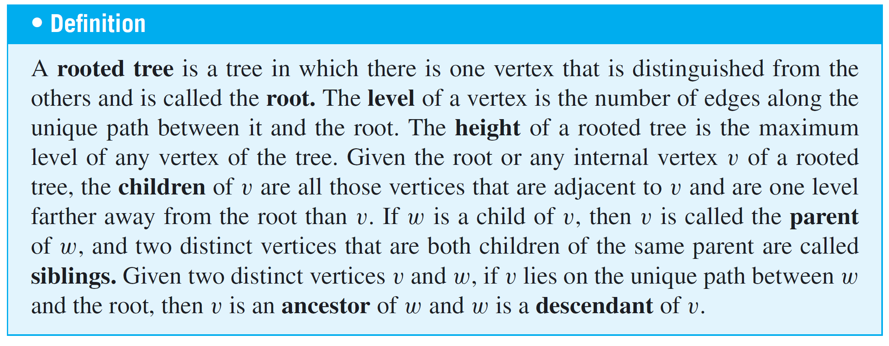
Rooted Trees
The number of edges in such a path is called the level of v, and the height of the tree is the length of the longest such path. It is traditional in drawing rooted trees to place the root at the top (as is done in family trees) and show the branches descending from it.

Slide 5
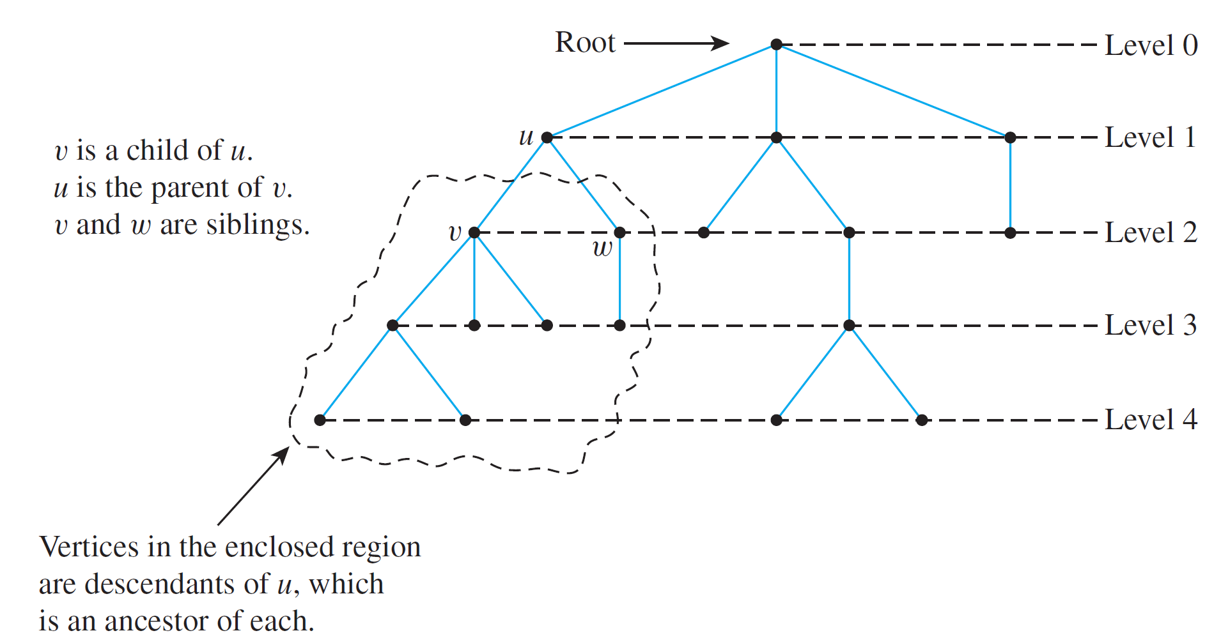
Rooted Trees
These terms are illustrated in Figure 10.6.1.
A Rooted Tree
Figure 10.6.1

Slide 6
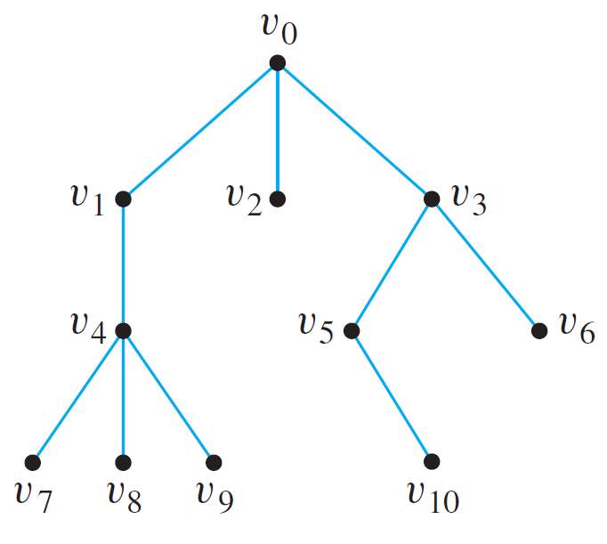
Example 1 – Rooted Trees
Consider the tree with root v₀ shown on the right.
a. What is the level of v₅?
b. What is the level of v₀?
c. What is the height of this rooted tree?
d. What are the children of v₃?
e. What is the parent of v₂?
f. What are the siblings of v₈?
g. What are the descendants of v₃?

Slide 7
Example 1 – Solution
a. 2
b. 0
c. 3
d. v₅ and v₆
e. v₀
f. v₇ and v₉
g. v₅, v₆, v₁₀

Slide 8
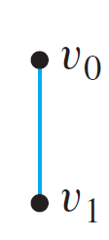
Rooted Trees
Note that in the tree with root v₀ shown below, v₁ has level 1 and is the child of v₀, and both v₀ and v₁ are terminal vertices.

Slide 9
Binary Trees

Slide 10
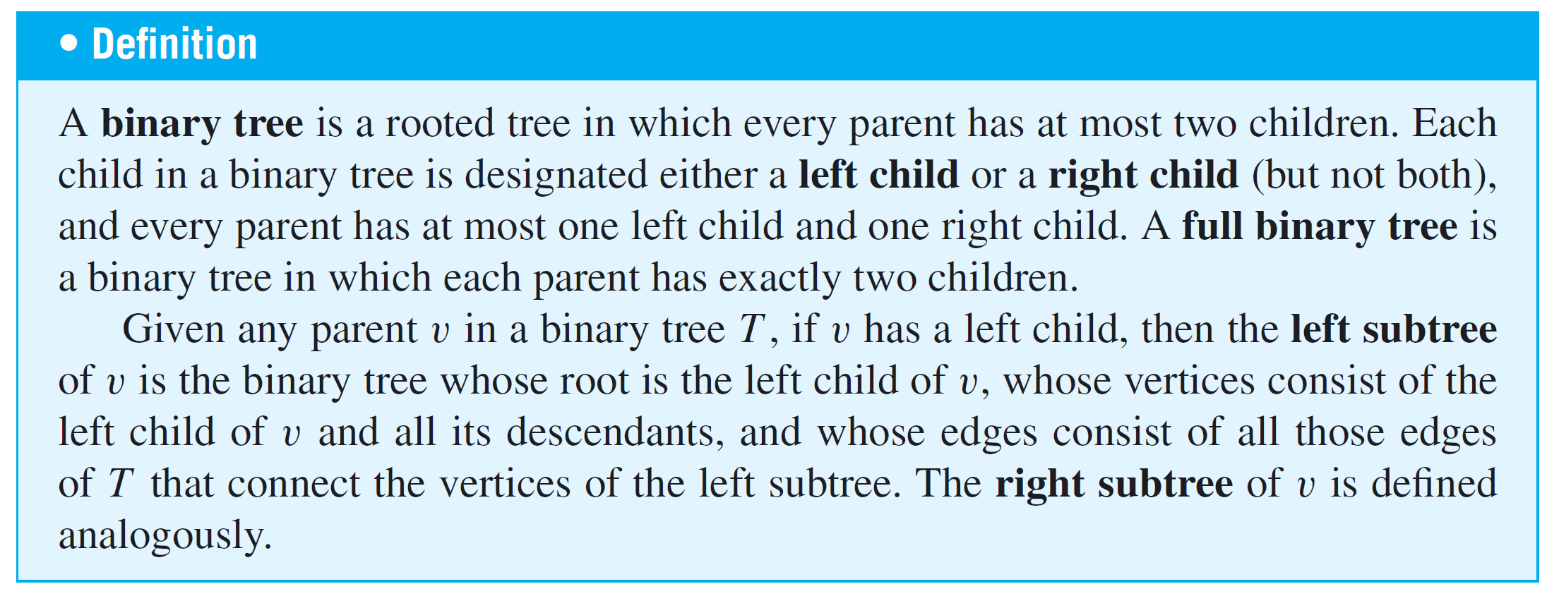
Binary Trees
When every vertex in a rooted tree has at most two children and each child is designated either the (unique) left child or the (unique) right child, the result is a binary tree.

Slide 11
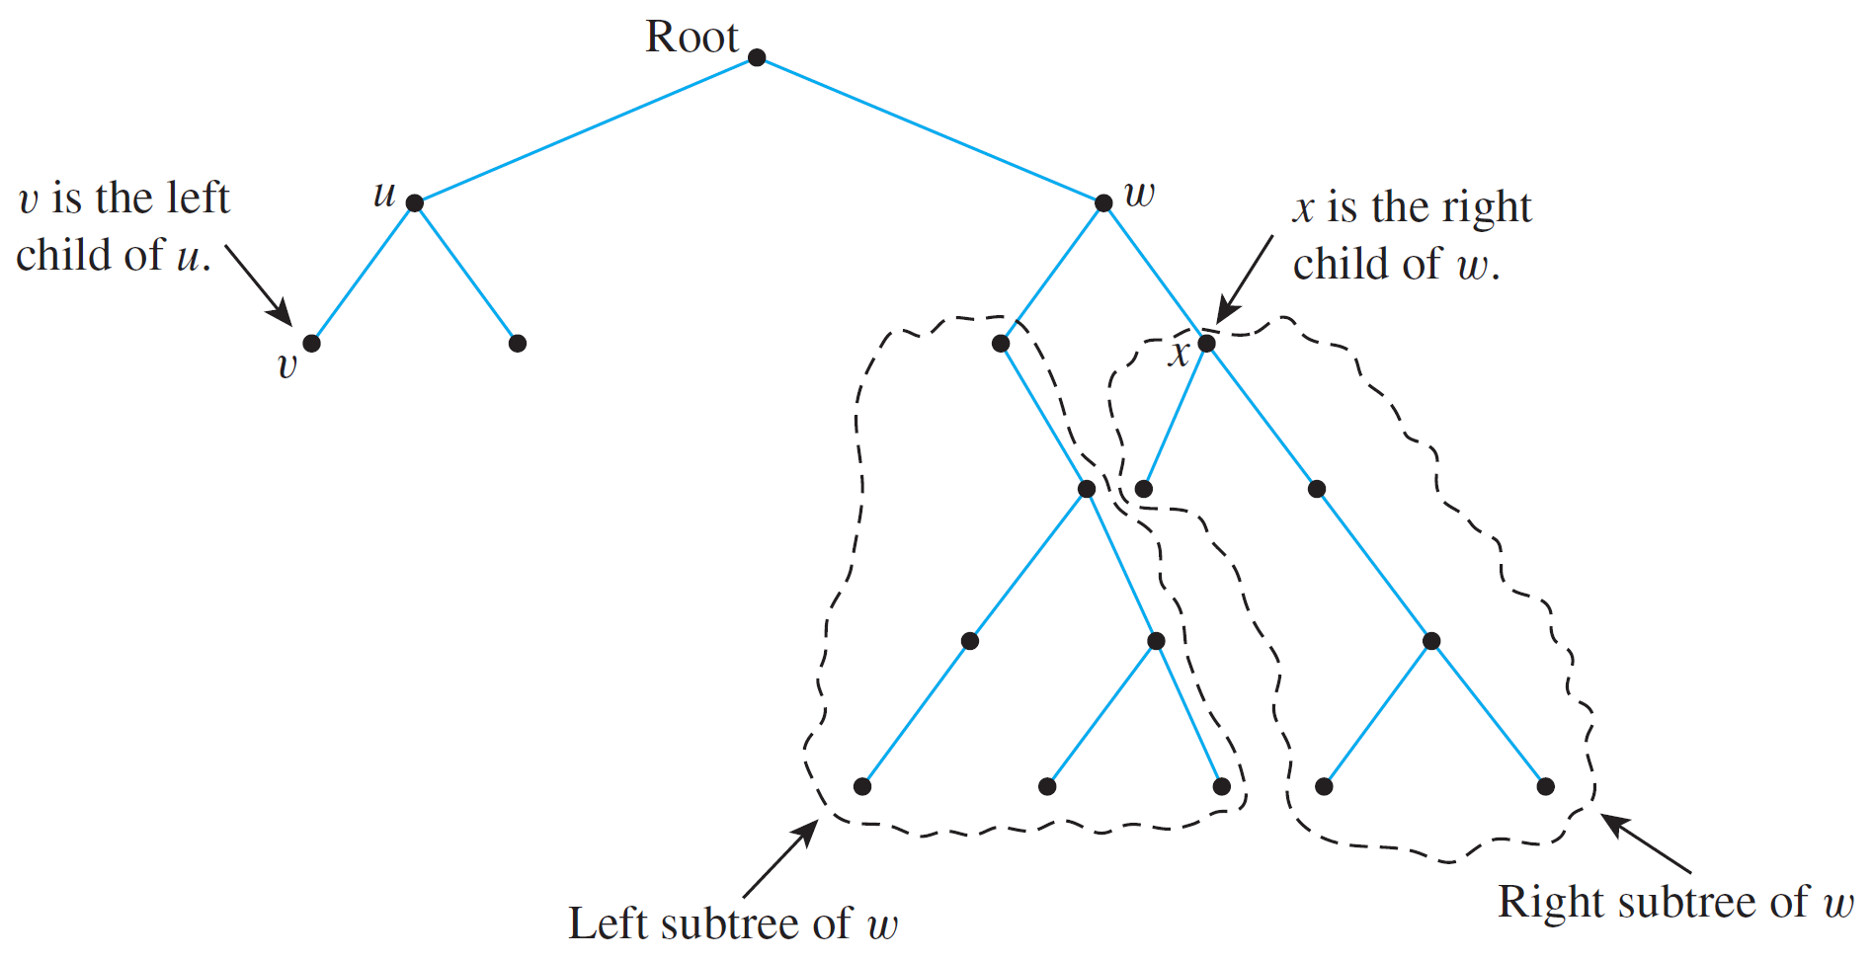
Binary Trees
These terms are illustrated in Figure 10.6.2.
A Binary Tree
Figure 10.6.2

Slide 12
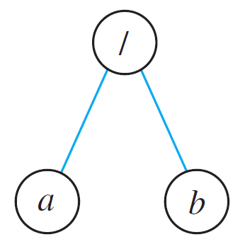
Example 2 – Representation of Algebraic Expressions
Binary trees are used in many ways in computer science. One use is to represent algebraic expressions with arbitrary nesting of balanced parentheses. For instance, the following (labeled) binary tree represents the expression a/b: The operator is at the root and acts on the left and right children of the root in left-right order.

Slide 13
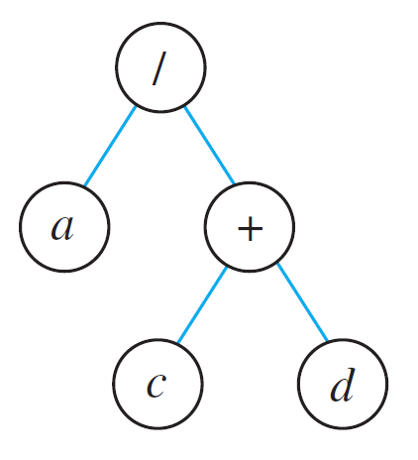
Example 2 – Representation of Algebraic Expressions
cont’d
More generally, the binary tree shown below represents the expression a/(c + d). In such a representation, the internal vertices are arithmetic operators, the terminal vertices are variables, and the operator at each vertex acts on its left and right subtrees in left-right order.
Draw a binary tree to represent the expression
((a – b)  c) + (d/e).

Slide 14
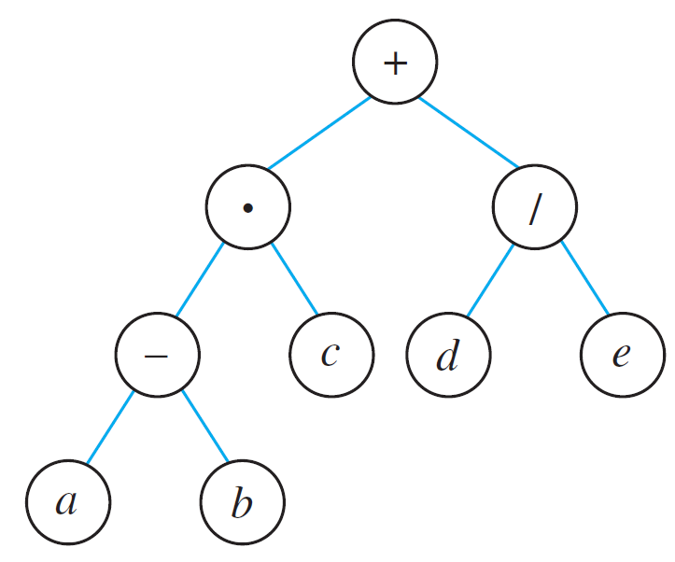
Example 2 – Solution
The binary tree to represent the expression
((a – b)  c) + (d/e), is as follows:

Slide 15
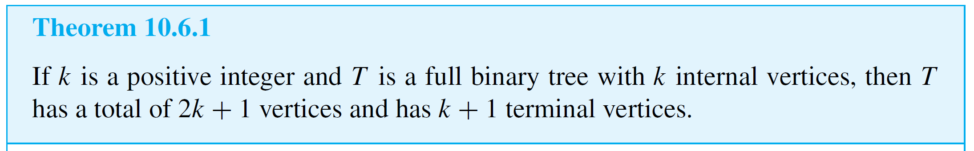
Binary Trees
An interesting theorem about binary trees says that if you know the number of internal vertices of a full binary tree, then you can calculate both the total number of vertices and the number of terminal vertices, and conversely. More specifically, a full binary tree with k internal vertices has a total of 2k + 1 vertices of which k + 1 are terminal vertices.

Slide 16
Example 3 – Determining Whether a Certain Full Binary Tree Exists
Is there a full binary tree that has 10 internal vertices and 13 terminal vertices?
Solution:
No. By Theorem 10.6.1, a full binary tree with 10 internal vertices has 10 + 1 = 11 terminal vertices, not 13.

Slide 17
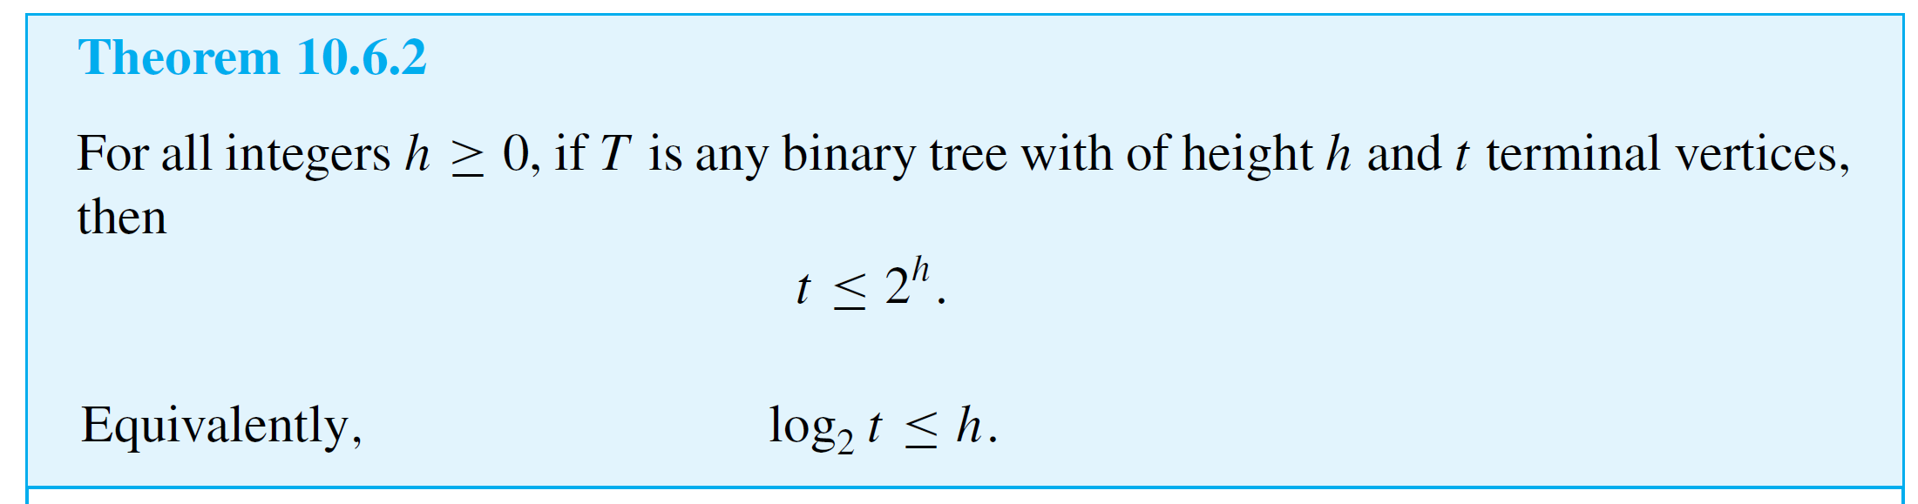
Binary Trees
Another interesting theorem about binary trees specifies the maximum number of terminal vertices of a binary tree of a given height. Specifically, the maximum number of terminal vertices of a binary tree of height h is 2^{h}. Another way to say this is that a binary tree with t terminal vertices has height of at least log₂t.

Slide 18
Example 4 – Determining Whether a Certain Binary Tree Exists
Is there a binary tree that has height 5 and 38 terminal vertices?
Solution:
No. By Theorem 10.6.2, any binary tree T with height 5 has at most 2⁵ = 32 terminal vertices, so such a tree cannot have 38 terminal vertices.

